Slide 1
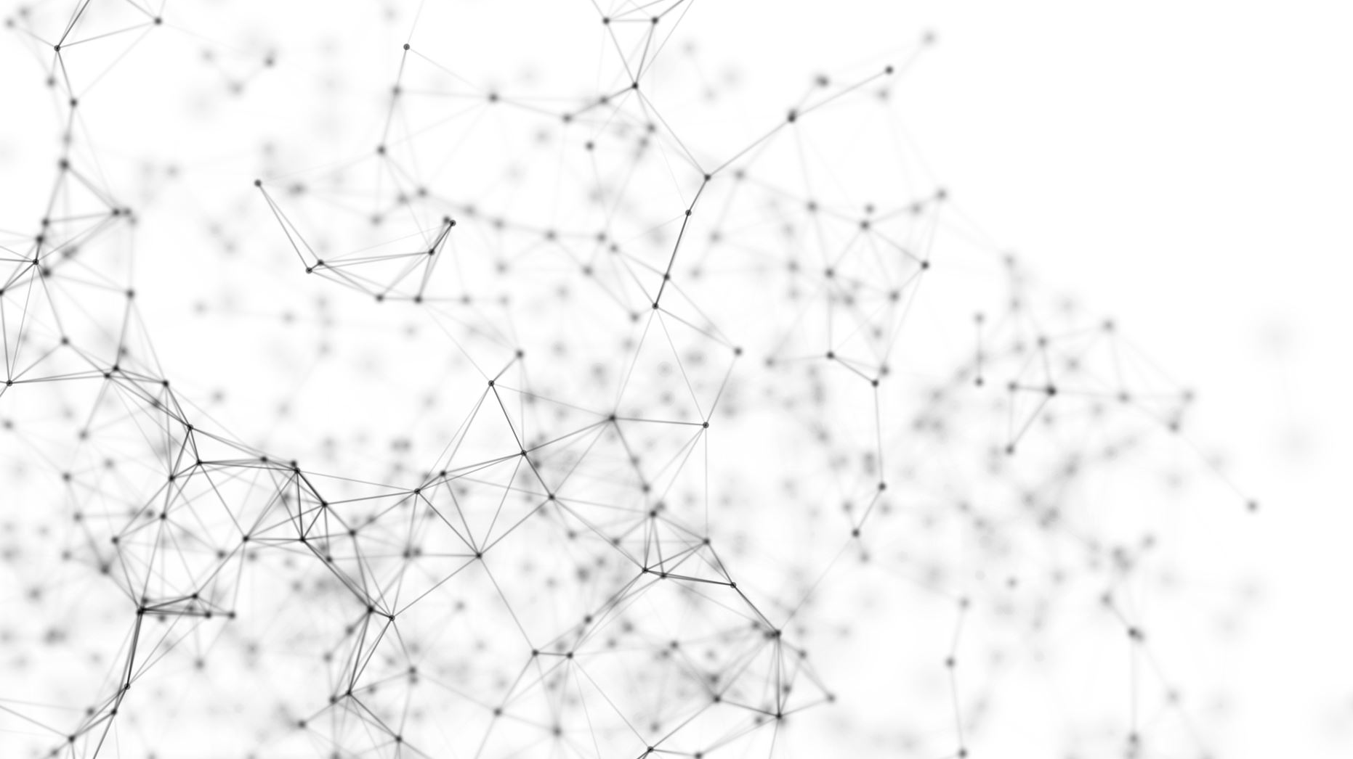
Computational Physic
Lesson 3 – Using Libraries

Slide 2
Learning Objectives
Appreciates the necessity of using libraries implementing numerical methods rather than writing all code from scratch.
Interacts with libraries to extract physically meaningful results
Uses libraries to solve differential equations.

Slide 3
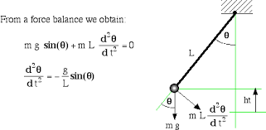
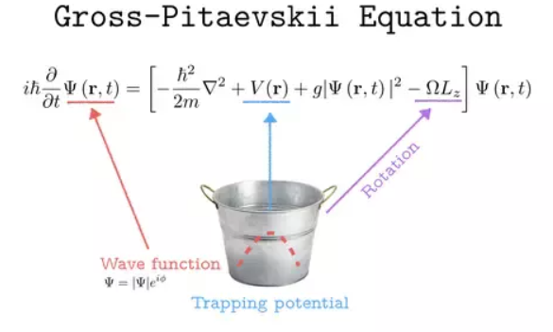
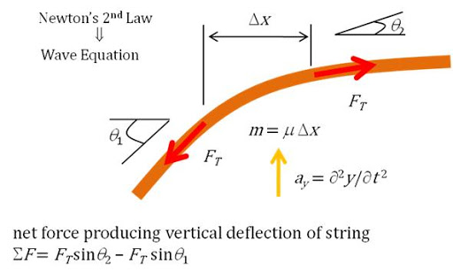
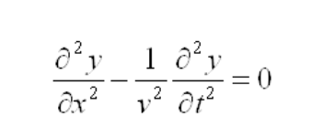
Differential Equations
Tell us about the rate of change of a variable.
Most physical problems can be expressed as DEs
Note on solutions – we also have to specify an initial value (the DE tells us how the variable changes)

Slide 4
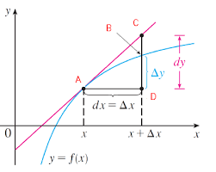
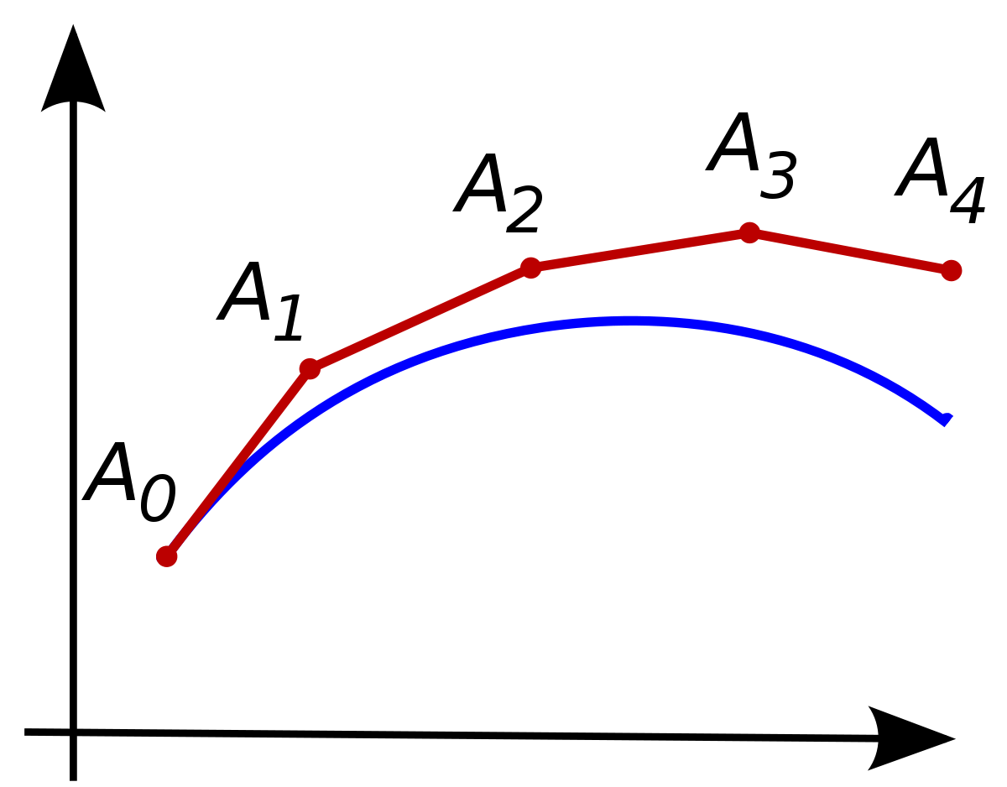

Solving (approximately)DEs using a computer
Idea: $\frac{dy}{dx}=f\left(x\right)$ tells us the rate of change of $y$ for a given value of $x$.
For a small change in $x$, from $x_{0 }$to $x_{0}+Δx$, the change in $y$ is:
$$Δy =\left(rate of change\right)×(change in x)$$
$$=\frac{dy}{dx}×Δx$$
$$=f\left(x_{o}\right)×Δx$$
If you do this trick many times, you can find $y$ for any value of $x$

Slide 5

More Detail
The choice of timestep ($Δx$) matters
The way we compute $Δy$ matters.

Slide 6
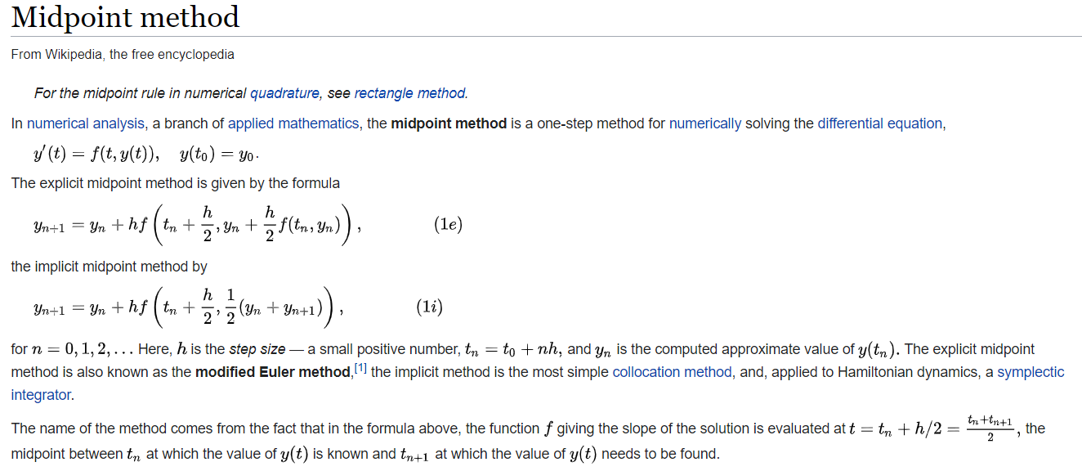
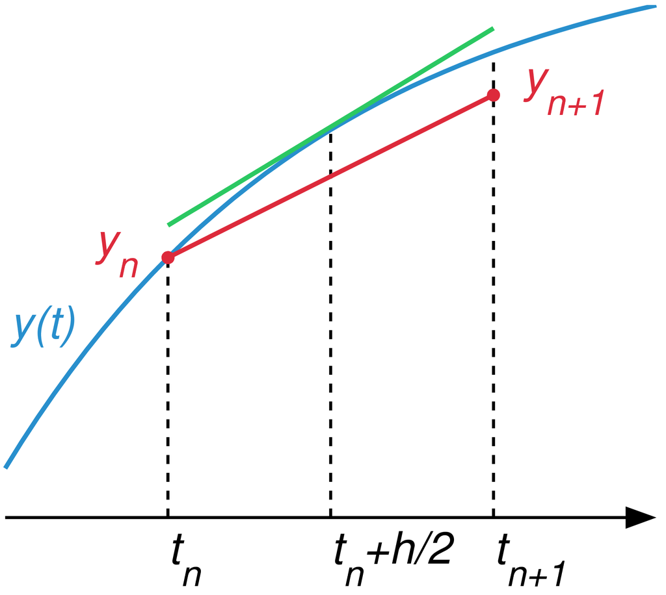
Example – Midpoint Method

Slide 7
Goals of the Scientist (in computing)
What are the goals of a scientist when they use computing to solve a problem?
How should a scientist spend their time?
What is a scientist likely to be good at?

Slide 8
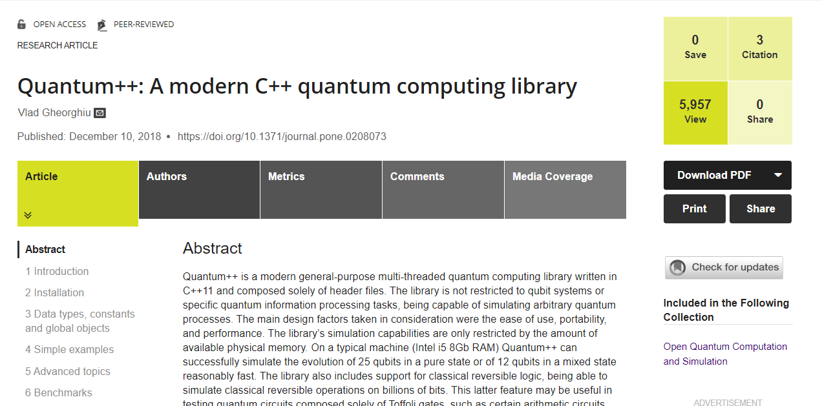
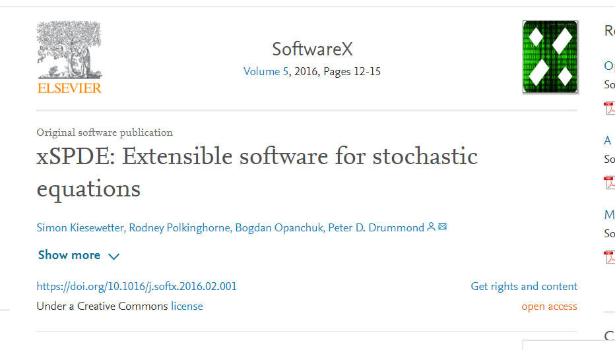
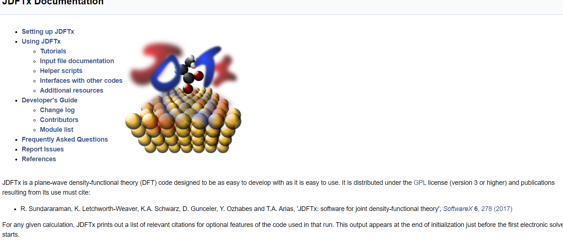
Some examples

Slide 9
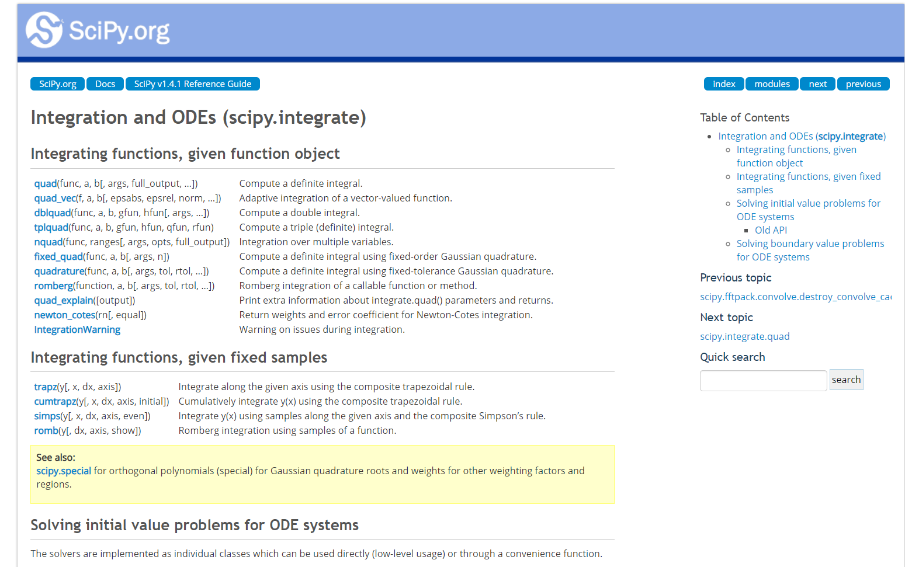

Slide 10
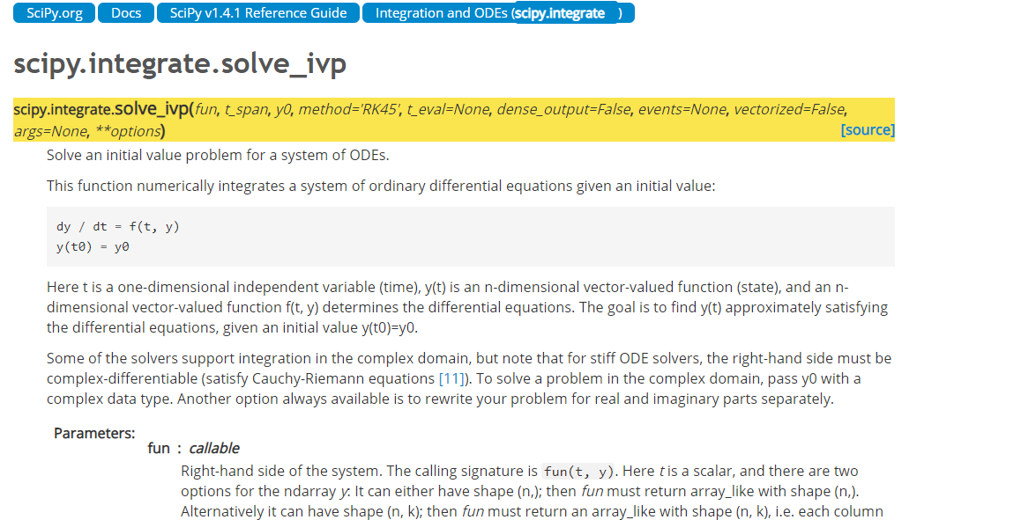

Slide 11
Further Reading
https://docs.scipy.org/doc/scipy/reference/generated/scipy.integrate.solve_ivp.html#scipy.integrate.solve_ivp

